Slide 1
Social Media
NLP
for
Social Media
Social Media
for
Crisis
NLP
NLP
for
Crisis
Crisis
Scope of this manuscript

Slide 2
National crisis cell
Response Teams
Information System
Regional crisis cell
Information processing & mngt
Decision makers
IS Operators
Rescue managers
External sources of information
Local crisis cell
Rescue operators
Information flow

Slide 3
Hub
Community

Slide 4
Danger
Risks
Stakes
Consequence
Event

Slide 5
Préfecture
Préfet (decision maker)
Communication team
ZONAL
Level
Firefighter representant
Police representant
Infrastructure representant
Other functions
Police, Gendarmerie
Météo France
Préfecture départementale
SDIS
Law enforcement
Weather forecast
DÉPARTEMENTAL
Level
Operational center Fire and Rescue
Préfet départemental
Calls processing
DDT
EMS
Rescue
Road infrastructure
Coordination
Rescue, Medical care
Mairie
COMMUNAL
Level
Communal Command Center
Fire station
Rescue, Medical care
Legend
Coordination
Information
flow
Order
Terrain
Intervention

Slide 6
Préfecture
Préfet (decision maker)
Communication team
ZONAL
Level
Firefighter representant
Police representant
Infrastructure representant
Other functions
Police, Gendarmerie
Météo France
Préfecture départementale
SDIS
Law enforcement
Weather forecast
DÉPARTEMENTAL
Level
Operational center Fire and Rescue
Préfet départemental
Calls processing
DDT
EMS
Rescue
Road infrastructure
Coordination
Rescue, Medical care
Mairie
COMMUNAL
Level
Communal Command Center
Fire station
Rescue, Medical care
Legend
Coordination
Information
flow
Order
Terrain
Intervention

Slide 7

SDIS 83
Representants:
Firefighters
Police
Infrastructure
COD
Communication Cell
VISOV
Dispatch information and coordination the different services
Simulation Cell
Provides inputs for the different actors according to the exercice plan
Information
Report
Order

Slide 8

SDIS 83
East CGI
Call takers
CODIS
Dispatch and coordination of deployed rescue teams
MSGU Cell
Emergency Response Command
Simulation Cell (+ VISOV)
Provides inputs for the different actors according to the exercice plan
Information
Report
Order

Slide 9
Information
Organization
Baseline
Actionable
Event
Environment conditions
Actors already involved
Responders’ needs
Resources available
Location
Credible
Context
Right role
Timely

Slide 10

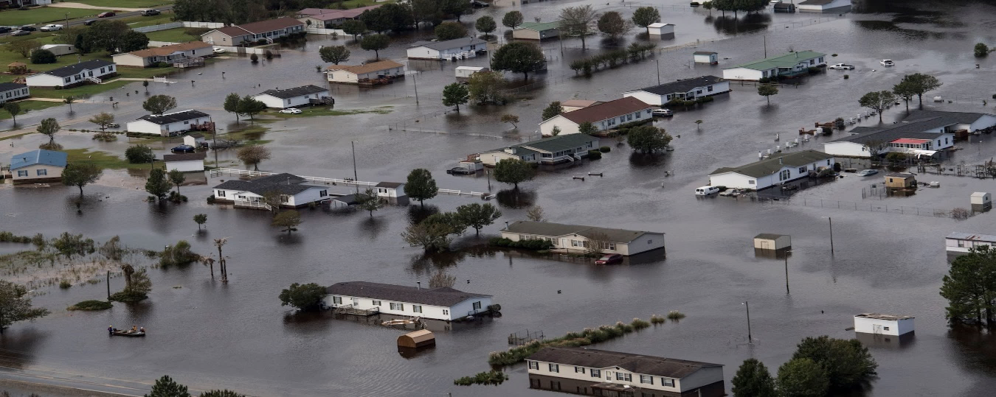






Legend
EMS
Police
Firefighters
Event
Time
t1
t1
t1
t1
Event Location
Event Context
Environ.
Respon.
Needs
Resources

Slide 11



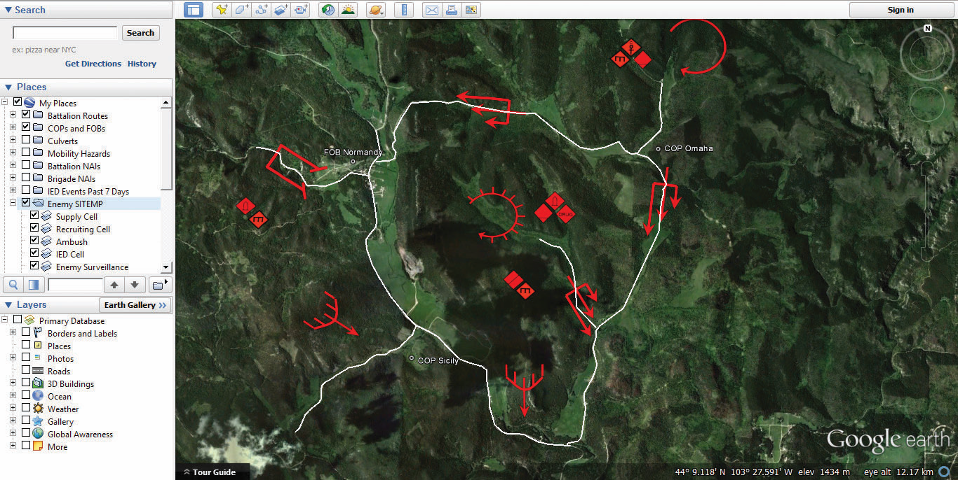







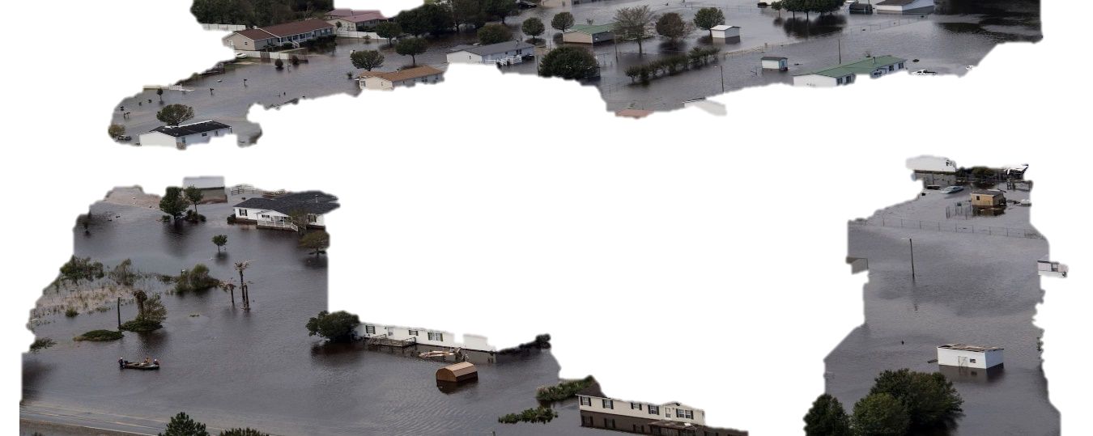
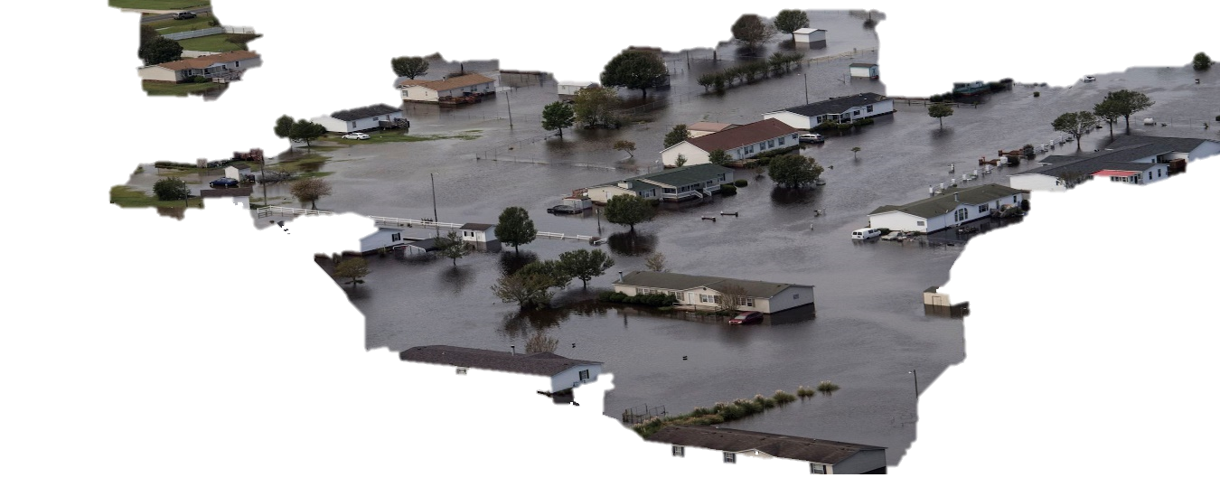




Crisis cell
Decisions
COP
3
1
2
Real World — Crisis Event
Virtual World Social Media

Slide 12




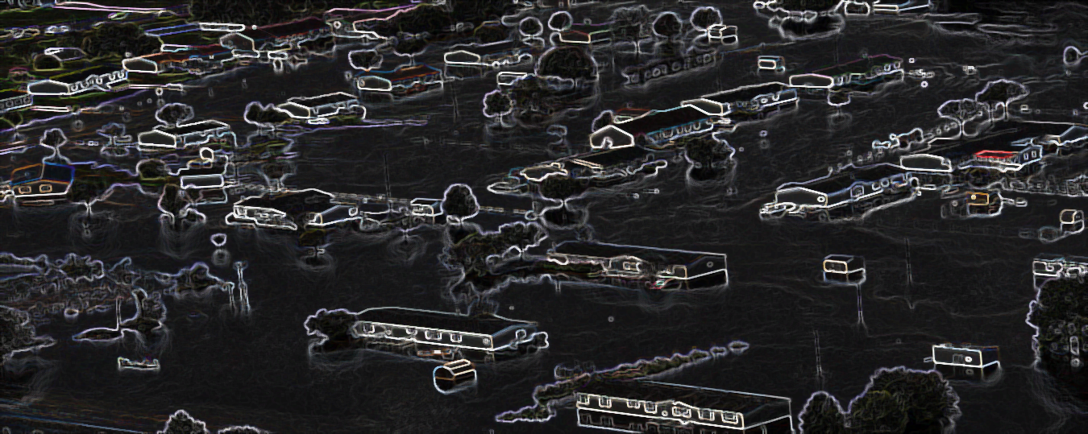










Call takers/SM Operators
2
Common Operational Picture
3
1
Aide a la decision
Decision Makers
Chapter order
Data flow
Decisions
Information Required

Slide 13
Call takers/SM Operators
2
3
Common Operational Picture
1
Decision Makers
Chapter order
Data flow
Decisions
Information Required

Slide 14
Call takers/SM Operators
Common Operational Picture
Decision Makers
Data flow
Decisions
Information Required

Slide 15
Call takers/SM Operators
Common Operational Picture
Decision Makers
Data flow
Decisions
Information Required

Slide 16
Call takers/SM Operators
Common Operational Picture
Decision Makers
Data flow
Decisions
Information Required

Slide 17





Informativeness
Information Model
Relevance
Eyewitness
Filtering
Entity
Recognition
Preprocessing
Previous
approaches
Our contribution
Call takers
SM Operators
Decision Makers

Slide 18

Language Model
Cops
Cops
Firefighters
BERT
Firefighters
Dimension reduction
Starfish
Firefighter
House
Starfish
0.1286, 1.5432
1.5438,-1,987
-1.8437, 0.1093
Roof
Starfish
UMAP
House
Roof
House
Flood
Fire
Flood
Fire
Clustering
HDBSCAN
Cops
Cops
Firefighters
Firefighters
Starfish
Roof
Starfish
House
Roof
Label Propagation
House
Flood
Flood
Fire
Fire

Slide 19
Event
location: Location
type: str
cause: str
severity: str
other: str
Environment
Actors Involved
Actors Needs
Resources Available
area details: str
population density: int
hazards: Hazard
other: str
professionals: Actors
civilians: Actors
resources: Equipment
other: str
actors: Actors
equipment: Equipment
casualties: int
other: str
actors: Actors
equipment: Equipment
other: str
Location
Hazard
Equipment
Actors
indication: str
address: int
type: str
location: Location
type: str
quantity: int
qualification: str
staffing: int

Slide 20











Slide 21
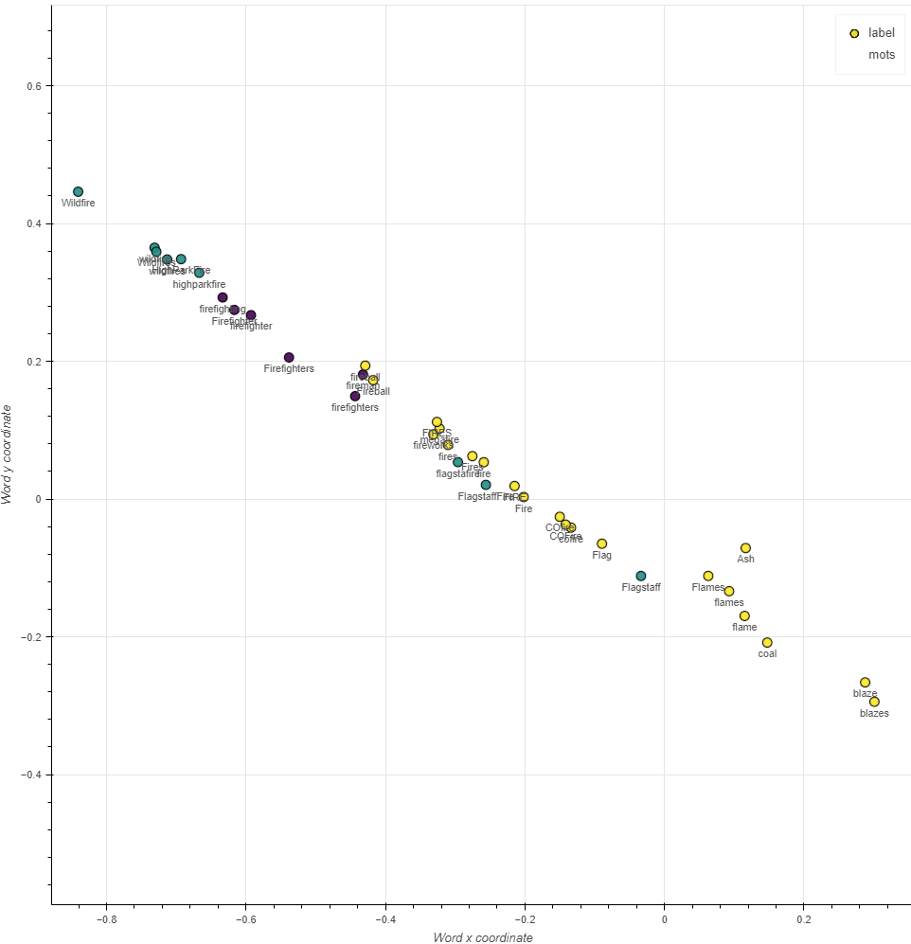
Event
Actors
Hazard

Slide 22

2. Preprocessing
1. Collection
3. Processing
Storage
Call takers
SM Operators
Decision Makers

Slide 23
Model Development
Objective Definition
Data Collection & Preparation
Feature Engineering
Model training
Model Evaluation
Model Maintenance
Model Monitoring
Model Deployment
Model Preparation
Model Serving
Machine learning engineering

Slide 24




Data System
Sensors
outputs
Raw data
Clean data
Clean data
Data Collection
Data Processing
Data Storage
Data Distribution
Model Development
Unlabeled
data
Users Interactions
Model Serving
Models Performances
Labeled data
Machine Learning Lifecycle
Predictions
Information Distribution
Information Storage
Information Processing
Information Collection
Organized inf.
Organized inf.
Unorganized inf.
Informative reports
Information System

Slide 25




Client Interface
Event Broker
Output thread
sends predictions
Model serving – Interp. Engine
reads predictions
sends requests
Input thread
reads requests
Social Media Operator
Model ready thread
gets model
ready
sends model
ready
Client Interface
Model training- Interp. Engine
sends labeled data
Labeled data thread
reads labeled data
Labeler

